Slide 1

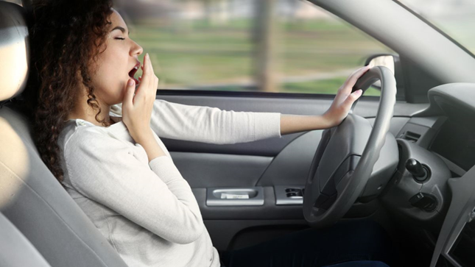
Driver Drowsiness Detection system using Machine Learning
Student 1: Adarsh Pranav Shukla (RA2011003010230)
Student 2: Akshat Gupta (RA2011003010221)
Guide Name: Dr. R. Jebakumar
SRM Institute Of Science and Technology
Course : 18CSP109L - MAJOR PROJECT

Slide 2
Abstract
Cab drivers work overnight. Many of them are deprived of their sleep. This will make them feel tired and drowsy and this might cause accidents while driving.
To prevent these accidents and help them stay awake , we are making a drowsiness detection system that will detect if the driver’s eyes are closed or open.
We will be using MRL Eye dataset which is an Open-source dataset containing more than 80k images of eyes with different attributes such as with glasses, reflections of eyes and partial state of eyes over different lighting conditions.
The Detection for the eyes will be done by using a CNN model to predict the states of eyes as Open or Close. We will use Method of Transfer Learning to determine better accuracy over different attributes of the image.
We will use OpenCV Haar Cascade and Dlib filters to detect and extract frame of Face and Eyes from the video stream and provide the frames to the Model for training.

Slide 3
Introduction
In an era where road safety is paramount, the development of a Driver Drowsiness
Detection system stands as a crucial innovation. Leveraging the power of Machine
Learning and computer vision, this project aims to enhance road safety by accurately
identifying signs of driver drowsiness. Through the analysis of facial features and subtle
cues, such as eye closure and head pose, the system acts as a vigilant guardian,
triggering timely alerts to prevent potential accidents. This cutting-edge technology
promises to mitigate the risks associated with driver fatigue, ensuring safer journeys for
all.

Slide 4
Problem Statement
Planning a model Drowsiness Detection framework which will zero in on ceaselessly
and precisely observing the condition of the driver's eyes continuously to check
whether they are open or shut for in excess of a given timeframe.
Flow sluggishness identification frameworks checking the drivers condition
demands complex calculation and costly gear, not happy to wear during driving and
isn't appropriate for driving conditions, For instance Electroencephalography (EEG)
and Electrocardiography (ECG),i.e., distinguishing he mind recurrence and
estimating the cadence of heart, individually.

Slide 5
Requirements
MRL Eye dataset, for various images of eyes under different conditions, such as with glasses, without glasses, with small reflections over the glasses, with greater reflections over the glasses, gender, lighting conditions and sensors with which the images were captured.
A system with minimum of 8gb RAM, intel i7 processor and a good graphic card, or a google colab notebook with a good gpu allocation and RAM and Memory.
An accurate Face and Eyes detection system, to precisely provided the detected frames to the the Model to predict.
Knowledge of Transfer Learning and Deep Learning.

Slide 6
Motivation
Enhancing Road Safety: The project develops a Driver Drowsiness Detection system to address risks linked to driver fatigue, aiming to save lives and create a safer road environment.
Innovative Machine Learning Application: This project showcases the practical use of machine learning, employing advanced algorithms and computer vision to address critical issues and transform public safety.
Proactive Accident Prevention: The system's real-time alerts for detected drowsiness represent a proactive approach, anticipating and mitigating potential dangers, fostering responsible driving, and reducing severe outcomes on the road.

Slide 7
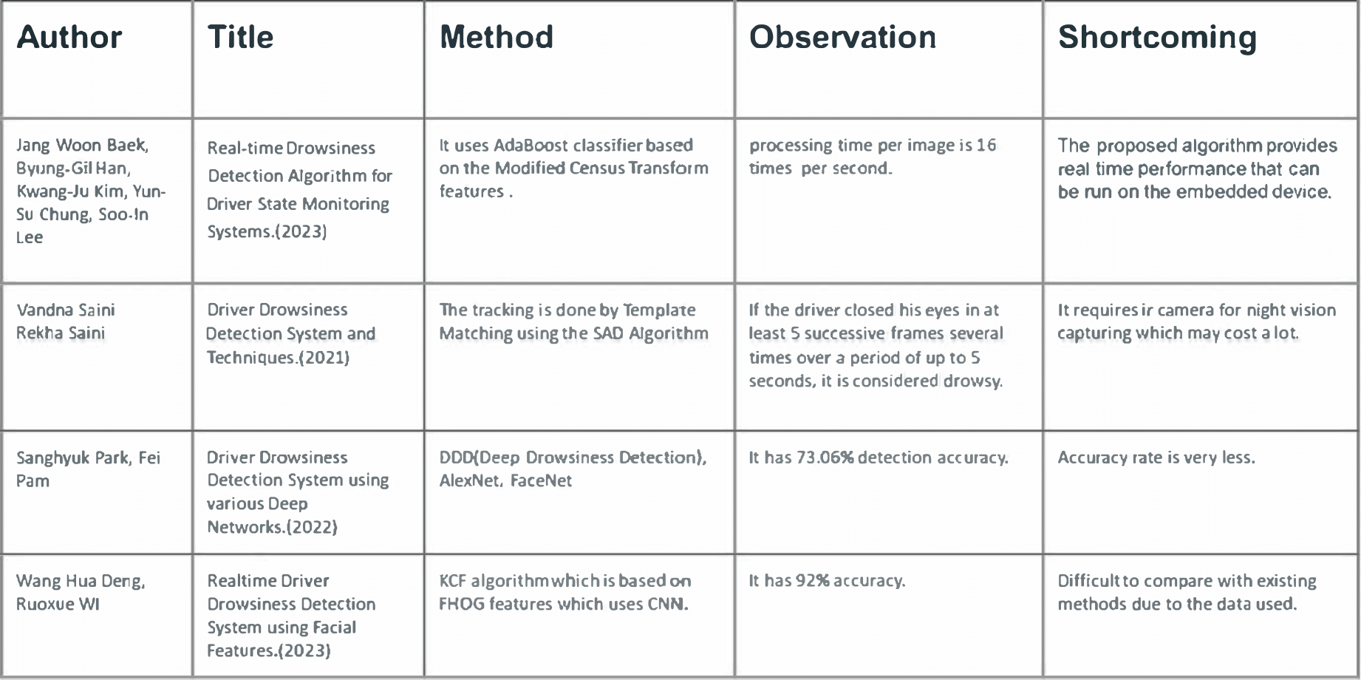
Literature Survey

Slide 8
Limitations and Research Gap
The drowsiness can be determined by many factors along with the state of one’s eyes. Yawning and head-toddling are some of the factors, where yawning can’t be used as an absolute defining factor and head-toddling may be because of one’s habitual behaviour or reaction against some music or an extreme case of drowsiness, but they still can’t be completely neglected. Furthermore physical measures like ECG, ECC may be more accurate in determining or forecasting drowsiness.
There’s always scope for improvements in the Model training or datasets requirements along with improvements in the detection of the interested region.
Infrastructure requirements also increases in case we move on with greater dataset or more complex Machine learning model, as training them will require very powerful hardware also.
Possibilities of new scientific innovations of discoveries in this field may also be considered on a regular basis to provide the most competent solution for the problem.

Slide 9
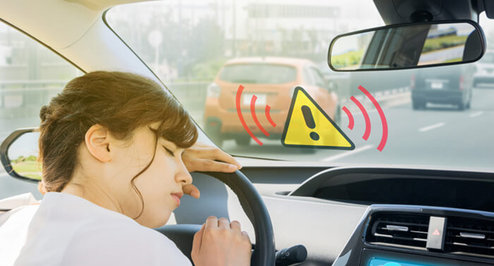
Objective
To avoid crashes caused by fatigue by advising drivers to take a break in time.
To detect closing of eyes using a webcam and give out an alarm sound to alert the driver.

Slide 10
Innovative Ideas
Innovative ideas for the Driver Drowsiness Detection project include real-
time alerts through steering wheel vibrations or audible signals, leveraging
advanced facial recognition for detecting yawning patterns, and
incorporating machine learning to analyze head movements. This
multifaceted approach enhances safety by addressing drowsiness beyond
traditional eye-tracking methods, ensuring a comprehensive monitoring
system.Moreover, integrating infrared sensors for accurate eye-tracking and
introducing adaptive lighting systems to prevent eye strain can further
enhance the system's effectiveness.

Slide 11
Novelty/Applications
Can be used in cars and other heavy vehicles to monitor the drivers. We can use this technology in some Apps such as Ola, Uber, Rapido, etc.
Can be used while studying to self-monitor ourselves.
Can be used in classrooms to monitor students.
Can be used to monitor in general.
We offer accuracy above 92%.

Slide 12
Proposed Architecture Diagram

Slide 13
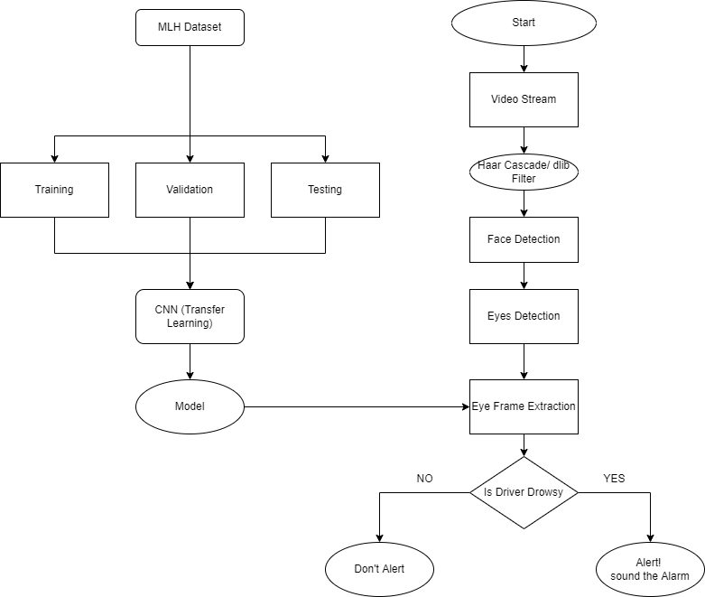

Slide 14
Use Case Diagram

Slide 15
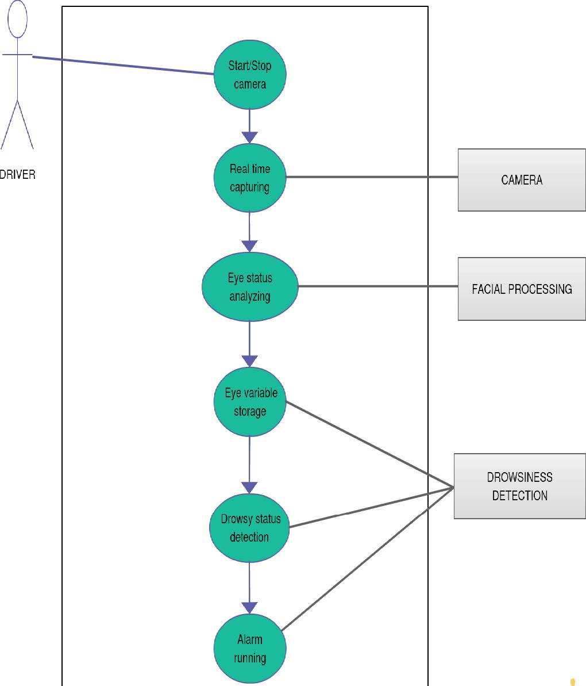

Slide 16
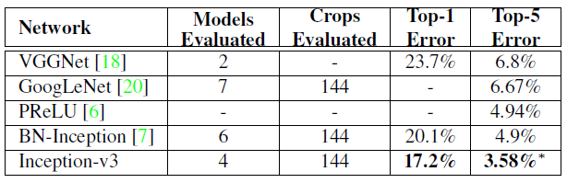
Module Description
Inception v3 is a convolutional neural network that was developed as a Googlenet module to help with image processing and object detection. It's the third version of Google's Inception Convolutional Neural Network, which was first unveiled during the ImageNet Recognition Challenge.
Inceptionv3 was designed to allow for deeper networks while still limiting the number of parameters: it has "under 25 million parameters," compared to 60 million for AlexNet.

Slide 17
Algorithm
For this we are using Haar-Cascade Algorithm
It is an Object Detection Algorithm used to identify faces in an image or a real time video.
Positive images – These images contain the images which we want our classifier to identify.
Negative Images – Images of everything else, which do not contain the object we want to detect.

Slide 18
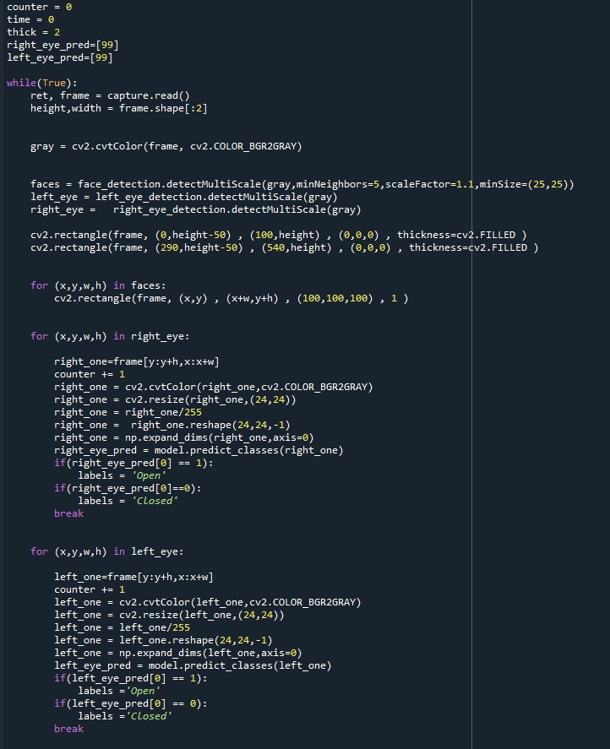
Architecture of Algorithm

Slide 19
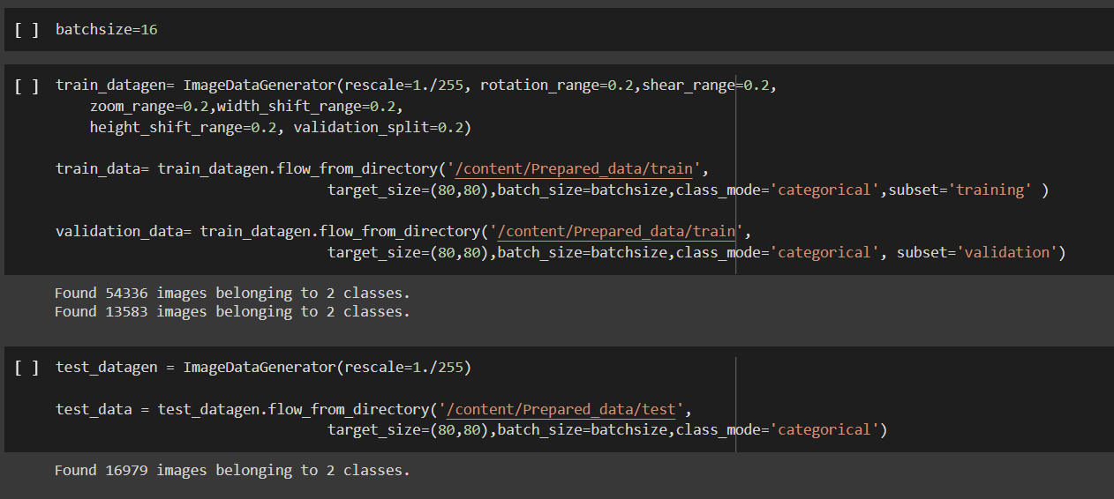
Implementations
Splitting Training and Test data and normalizing the images

Slide 20
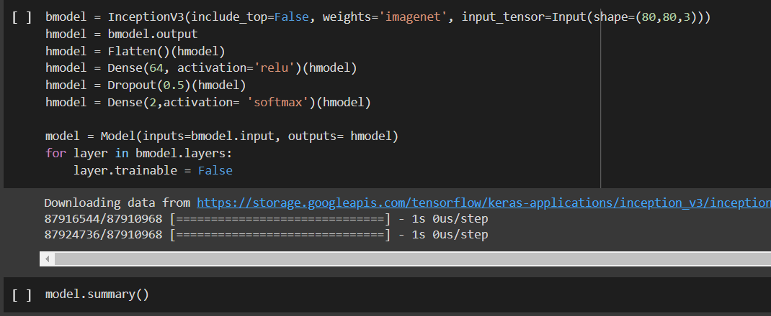
Creating Base Model for Transfer learning: Inception V3

Slide 21
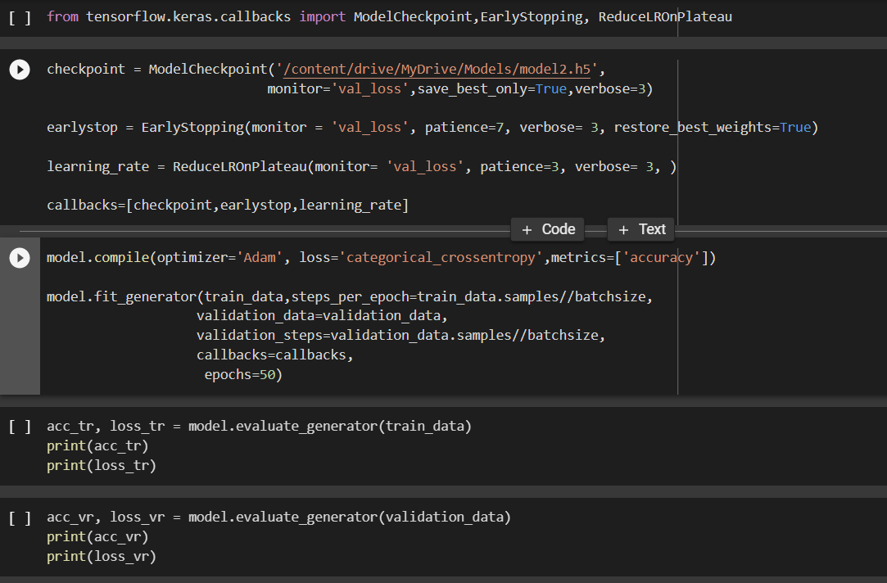
Training the model with batch size 16 and 50 Epochs

Slide 22
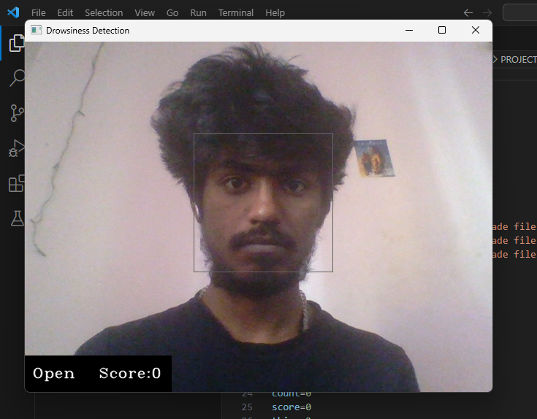
Results
When Awake

Slide 23
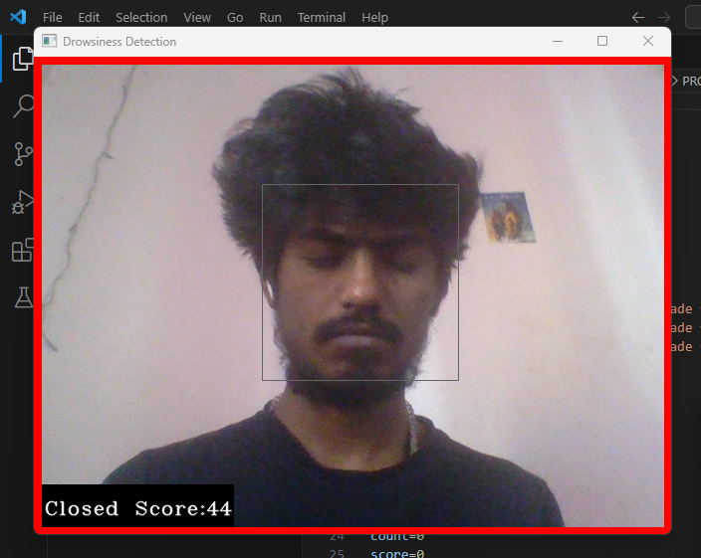
When Eyes Are Closed

Slide 24
References
[1] Mall, P. K., Narayan, V., Pramanik, S., Srivastava, S., Faiz, M., Sriramulu, S., & Kumar, M. N. (2023). FuzzyNet-Based Modelling Smart Traffic System in Smart Cities Using Deep Learning Models. In Handbook of Research on Data-Driven Mathematical Modeling in Smart Cities (pp. 76-95). IGI Global.
[2] Mall, P. K., Yadav, R. K., Rai, A. K., Narayan, V., & Srivastava, S. (2023). Early Warning Signs Of Parkinson’s Disease Prediction Using Machine Learning Technique. Journal of Pharmaceutical Negative Results, pp. 2607-2615, 2023.
[3] Mayank Jain, Muskan Prakash and Gokul V. Rajan, "Driver Drowsiness Detection Using DLIB", In 2022 2nd International Conference on Advance Computing and Innovative Technologies in Engineering (ICACITE), pp. 1162-1166, 2022.
[4] J Yu, Z Chen, Y Zhu, Chen YJ, L Kong and M. Li, "Fine-grained abnormal driving behaviors detection and identification with smartphones", IEEE Trans Mobile Comput, vol. 16, no. 8, pp. 2198-212, 2022.
[5] Drowsiness Detection with Machine Learning by Grant Zhong Towards Data Science, pp. 204-267, 2021

